Slide 1
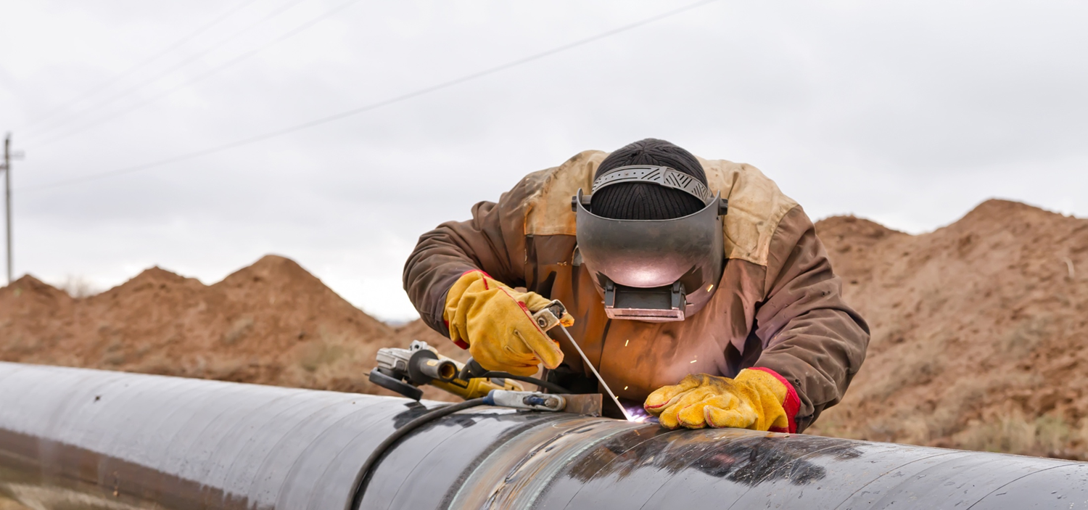
Fast Construction.
Permanent Protection.
FLEXSLEEVE™
WELDED JOINTS FOR INTERNALLY COATED PIPELINES
Comparison to Competitor Internal Sleeves

Slide 2
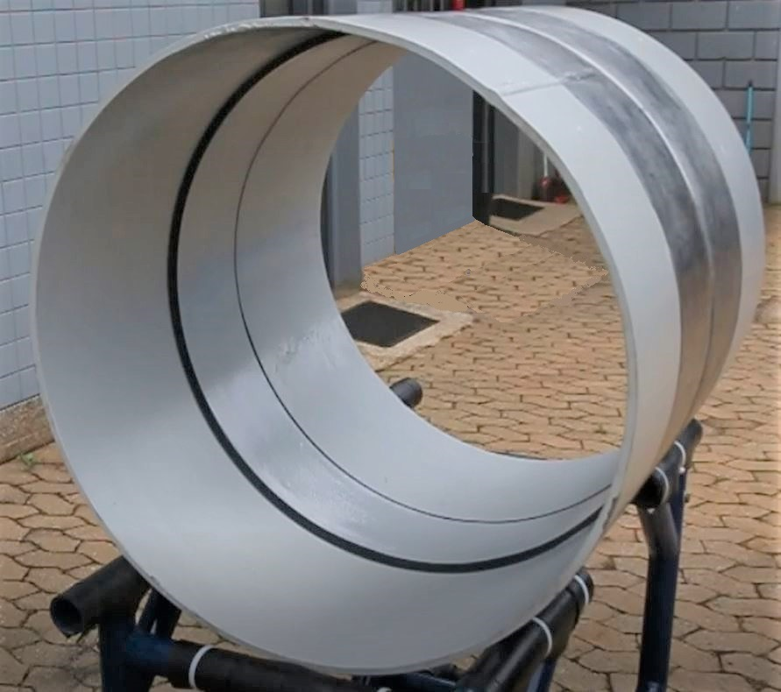
The FlexSleeve™ Solution
A flexible corrosion-resistant sleeve that withstands welding heat
and prevents liquids from reaching the weld zone.

Slide 3
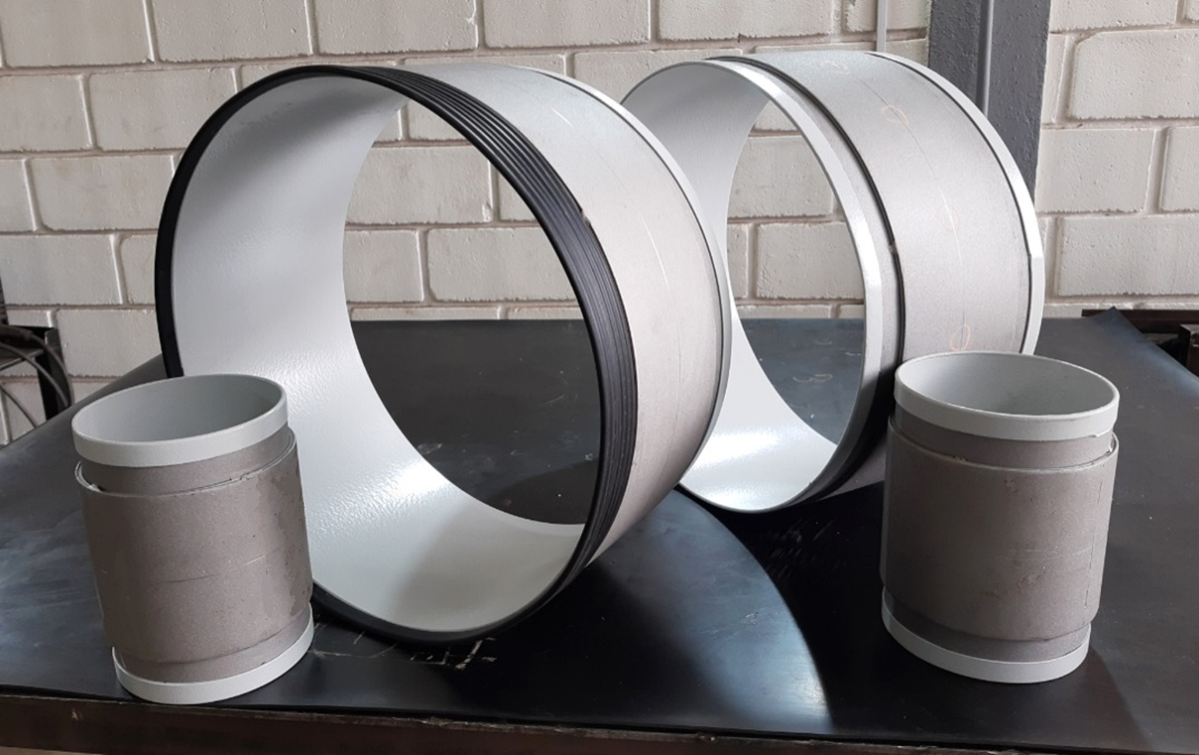
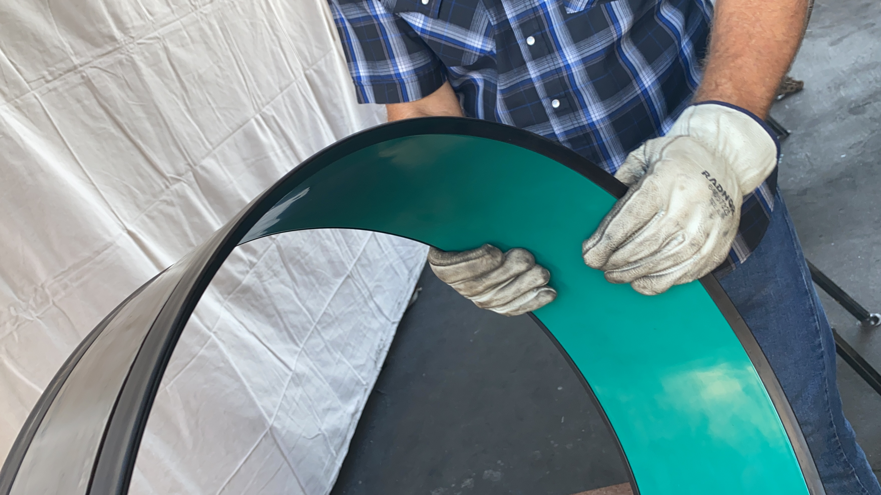
FlexSleeve™ Innovation
The innovative sheet-metal design permits the flexibility that’s vital to easy insertion, sealing, and weld quality.
The unique bore seal works in conjunction with the sleeve flexibility to permanently seal off the weld zone from liquids.

Slide 4
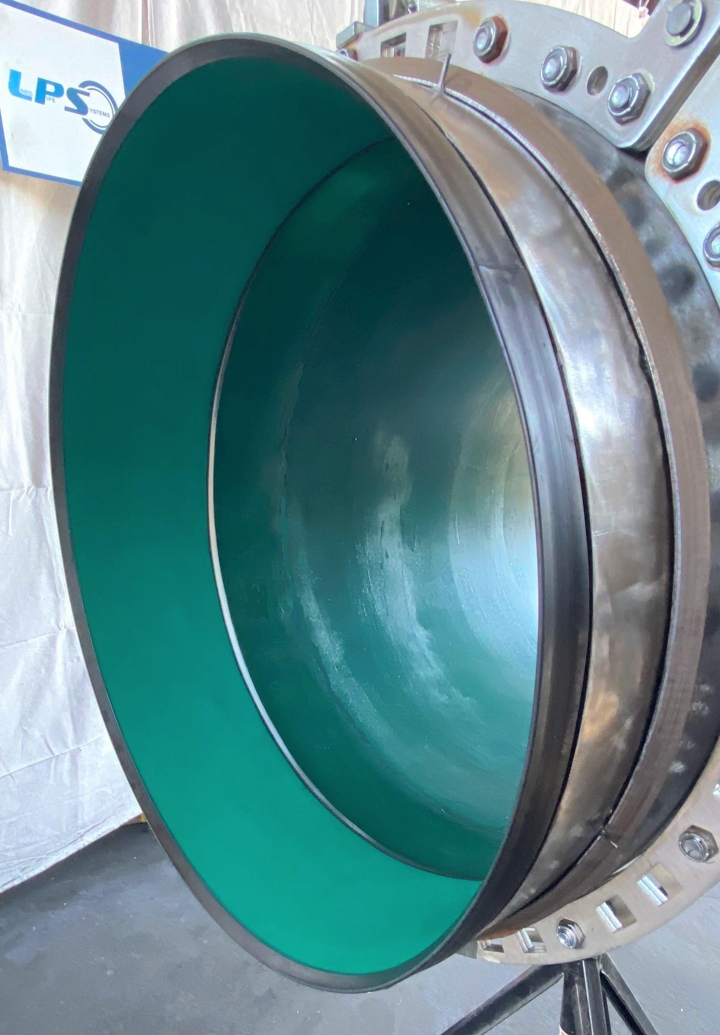
FlexSleeve™ Innovation
Flexibility: Thin, flexible profile adjusts to pipe ovality for easy insertion and consistent weld & seal quality.
Sealing: Unique bore seal design accommodates pipe ID tolerance and utilizes sleeve flexibility to seal off weld zone.
Heat Resistance: Wide, thick insulation keeps weld heat from damaging protective coating. Permits a long internal pipe coating holdback and normal welding time.
Light Weight: Allows for easy handling and insertion.
Large Diameter Pipelines: Flexibility, seal design, and light weight makes FlexSleeve suitable for pipe up to 80” diameter.
Long Distance Pipelines: Fast and easy sleeve installation. Normal weld times. Functions with internal pipe alignment clamps for automatic welding.

Slide 5
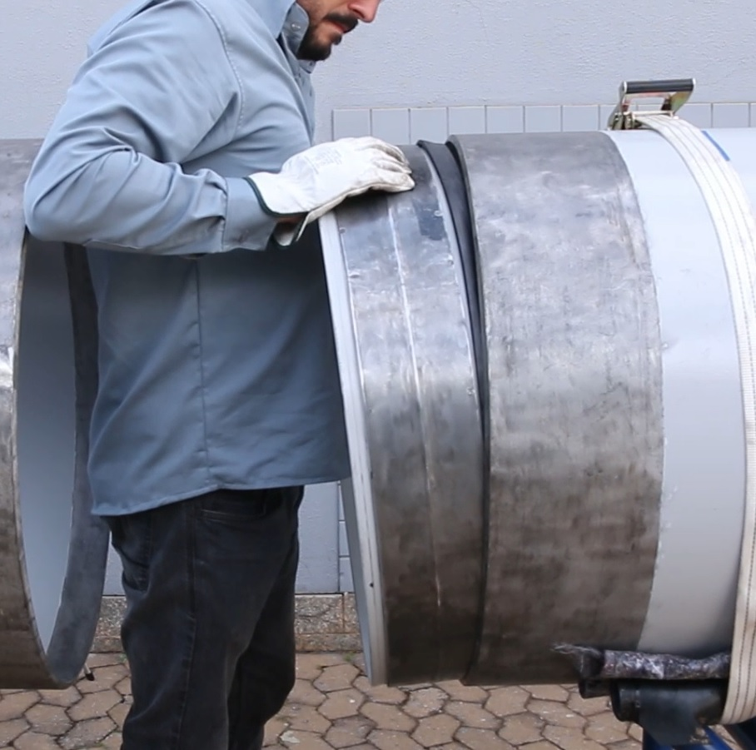
Easy Insertion
FlexSleeve | Competitor Sleeves
Silicone grease for lubricant. | 2-part epoxy used for lubricant.
Rubber seals guide sleeve into pipe ends. No sleeve OD/pipe ID interference. | Sleeve OD metal often interferes with pipe ID when pipe ends are out-of-round.
Sheet metal conforms to pipe ovality. | Solid steel does not conform to pipe ovality.
One size sleeve fits ID tolerance range for factory pipe ends per API 5L table 10. | One size sleeve does not fit entire API 5L ID tolerance range.
Watch the insertion video:
https://youtu.be/MXw7fR7fQlU

Slide 6
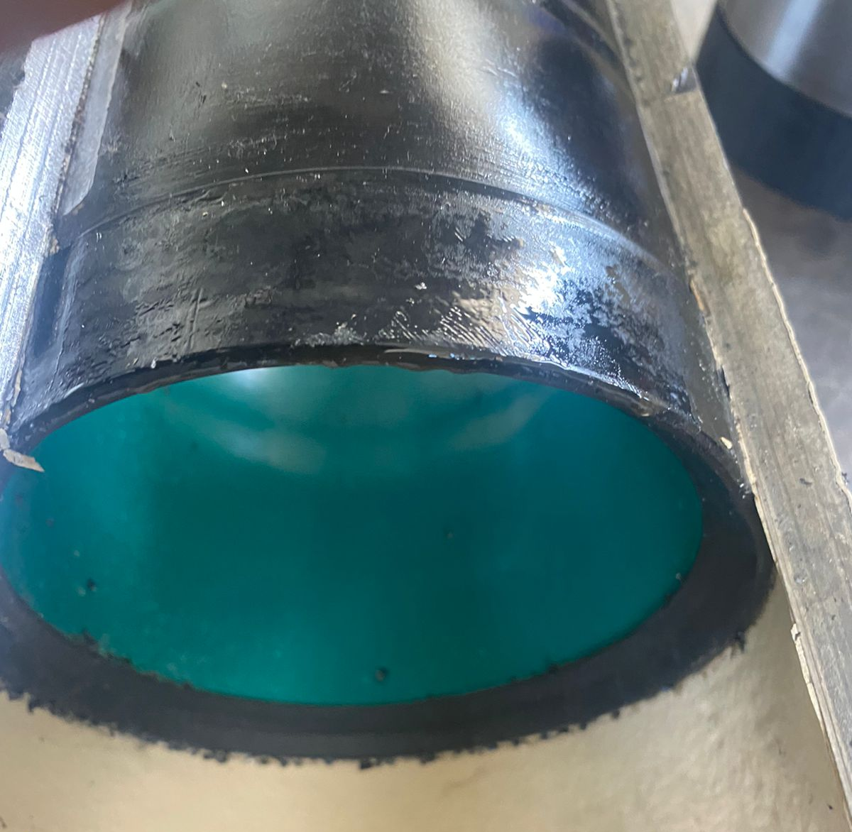
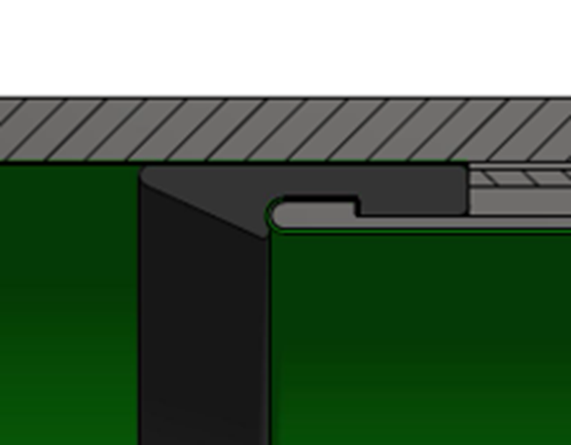
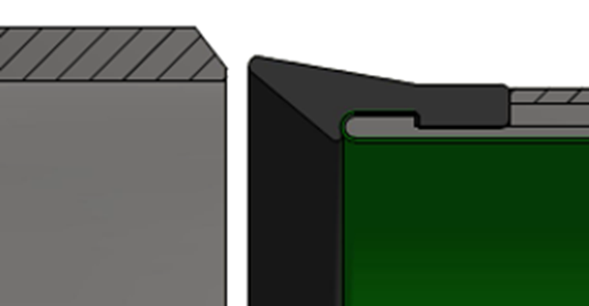
Sealing
FlexSleeve | Competitor Sleeves
Sleeve conforms to pipe shape, creating even seal pressure around entire circumference. | Solid machined steel does not easily conform to pipe shape. Uneven sealing pressure with out-of-round pipe ends.
Pipe pressure expands sheet metal and pinches seals between sleeve OD & ID coating. | Solid machined steel does not easily expand and utilize pipe pressure to enhance seal pressure.
Seal designed to accommodate pipe ID & ovality tolerance range. | O-rings not designed to seal with pipe ID & ovality tolerance range.
Image of FlexSleeve after hydrotest. Pipe
milled away to see bore seal functionality.

Slide 7
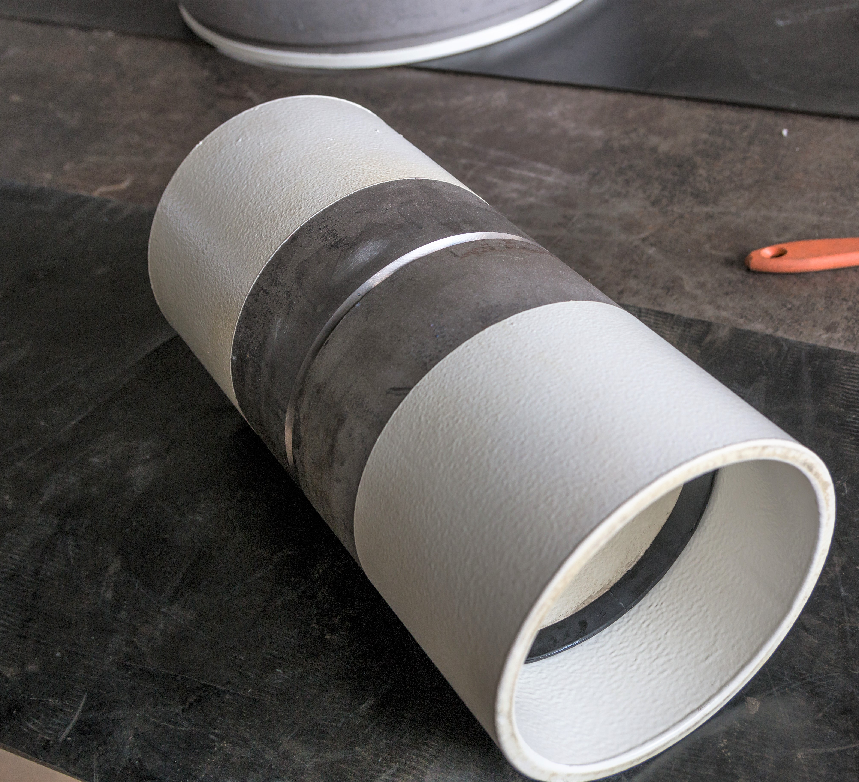
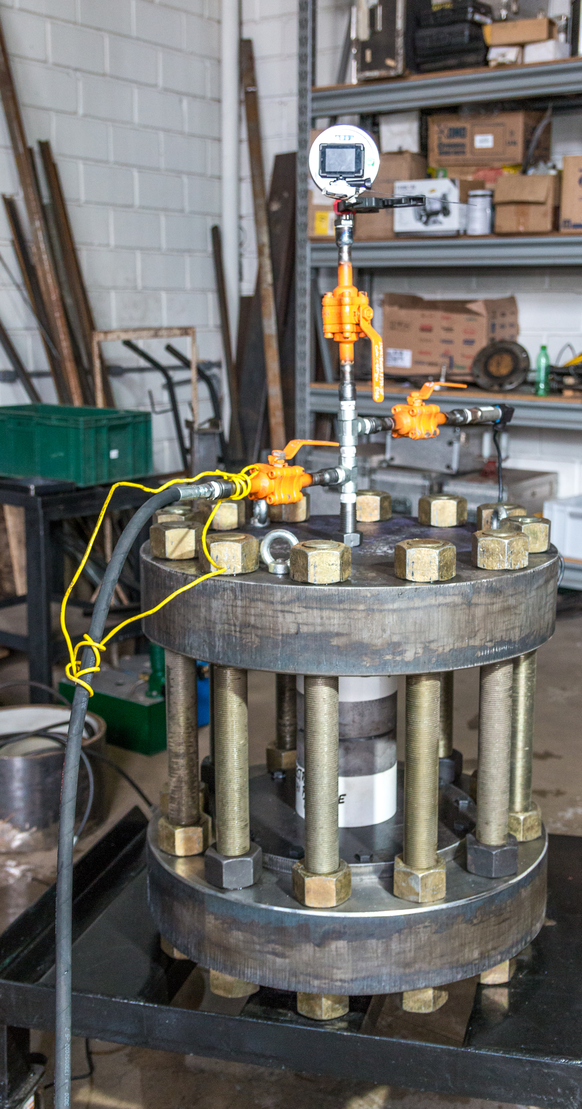
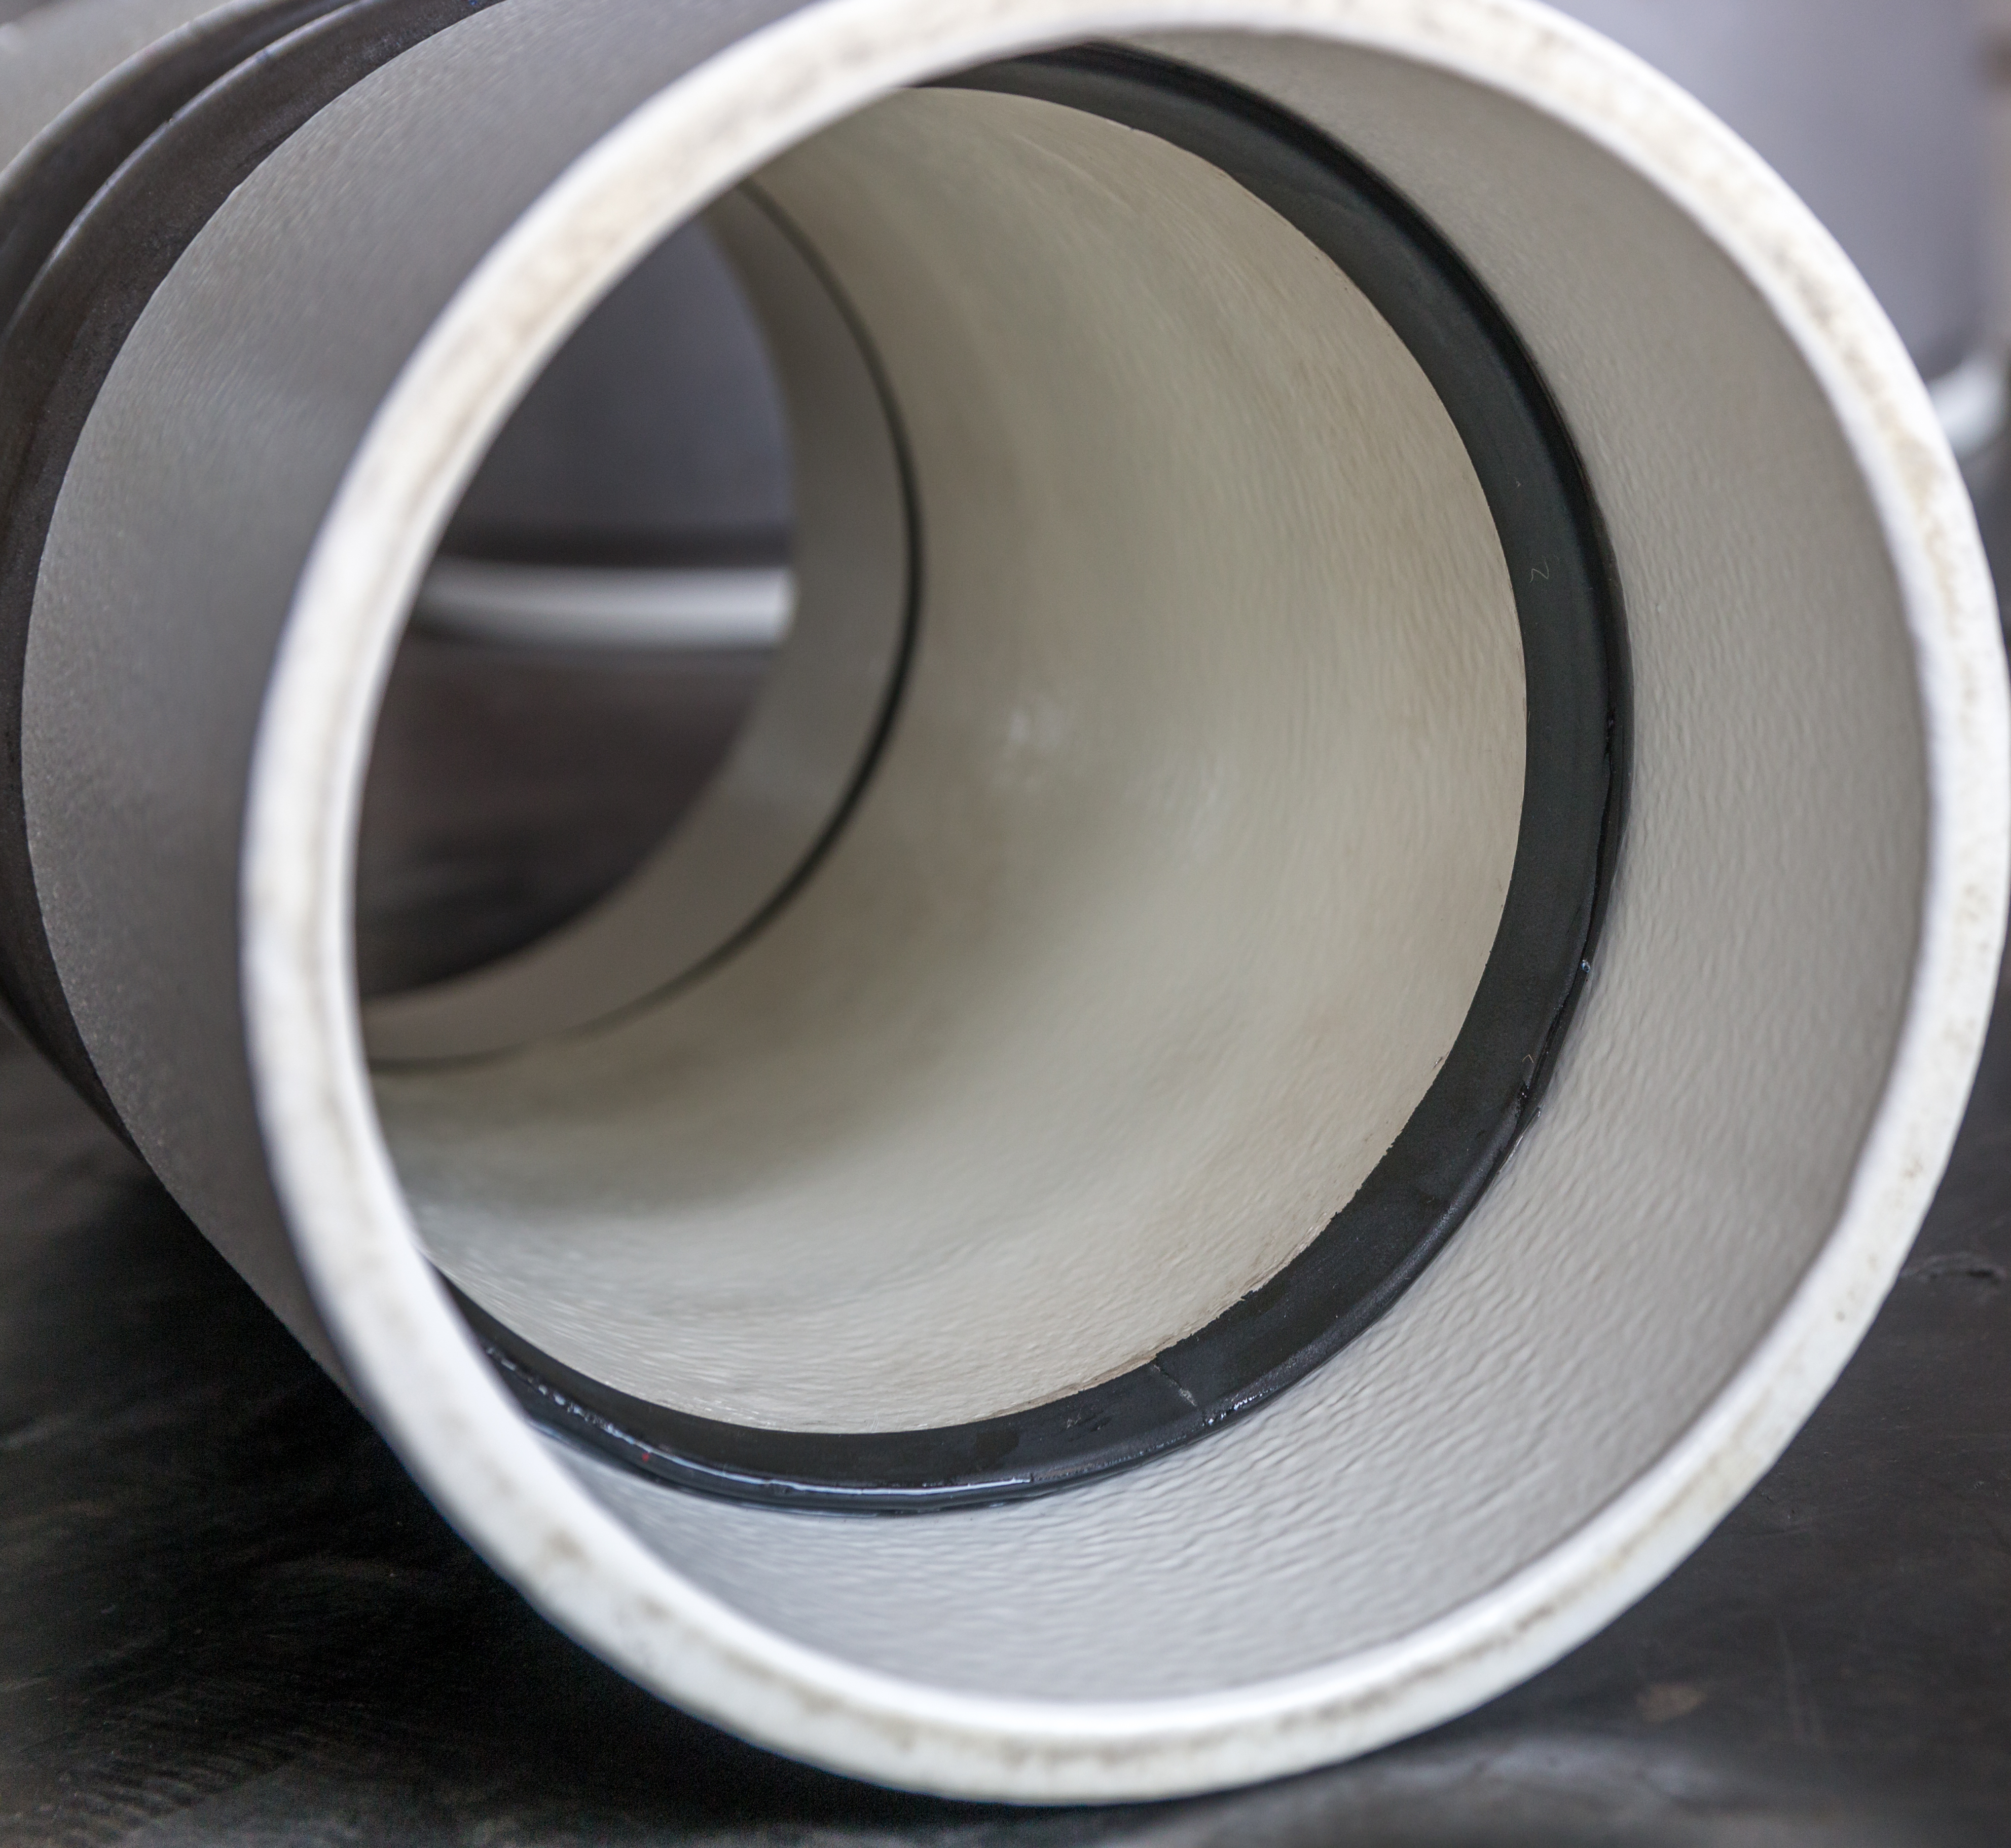
The Seal Test
The pipe is charged to pressures exceeding 300 bar (4,350 psi) without any weld at all.
FlexSleeve’s unique seals prevent liquid from reaching the weld zone and causing corrosion.
Hydrostatic pressure test with 6” dia.
sch. 80 pipe without any weld

Slide 8
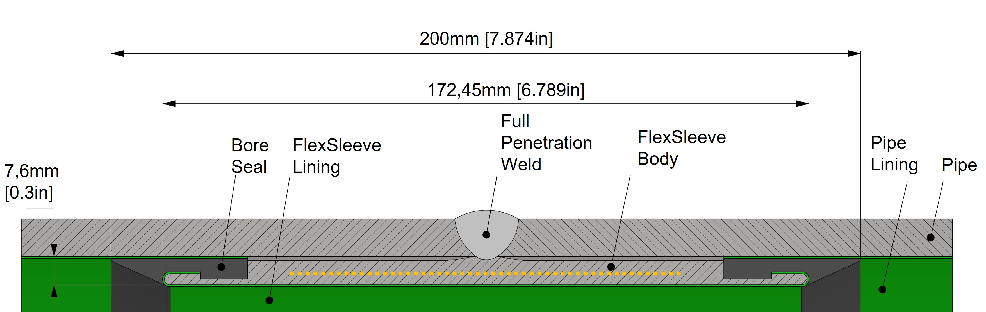
Cross Section Comparison
FlexSleeve
(actual sheet metal
configuration not shown)
Competitor Sleeve
Feature | FlexSleeve | Competitor Sleeve
Sealing | Bore seals accommodate pipe ID tolerance. Pipe pressure helps seal. | O-rings don’t consistently seal. Epoxy sealant required.
Pipe Coating Cutback | 2.5” | 1 – 1.5”
Heat Resistance | 1/8” thick x 4” wide insulation | ~1/16” thick x ~2” wide insulation
Stiffness | Assembled from sheet metal | Machined from solid blank/tubing

Slide 9
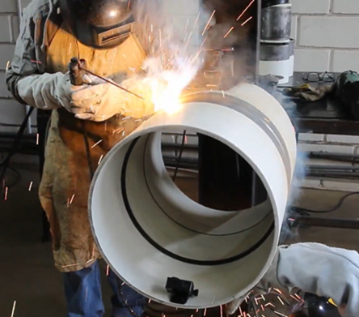
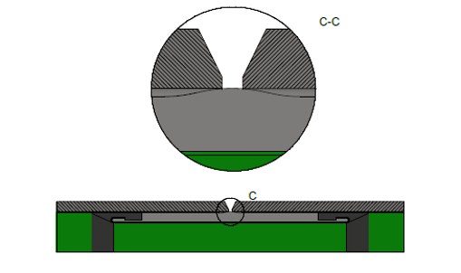
Welding
Raised center hump allows for consistent, high-quality root pass around entire circumference. Avoids slag entrapment that may occur when OD of sleeve is far from pipe ID.
250° F (120° C) max interpass temperature before starting next weld pass.
AUT, MUT, and RT examinations performed on completed welds are consistently approved by independent labs and inspectors.
FlexSleeves work with external automatic welding & internal lineup clamps.

Slide 10
Contact Information
FLEXSLEEVE™
WELDED JOINTS FOR INTERNALLY COATED PIPELINES
Lined Pipe Systems
Ryan Sears
Mobile: +1 951-288-5570
rsears@linedpipesystems.com

